Slide 1
Competitive Programming
09 Sep. 2023
Andrei Novikov

Slide 2
Hash Table
The Hash Table is advanced technology that allows to perform all operation with average complexity O(1).
The most important part of hash tables is to find a hash function that will allow us to have the average complexity O(1).
In worse case, when hash points to the same element, the complexity will be like list Θ(N).

Slide 3
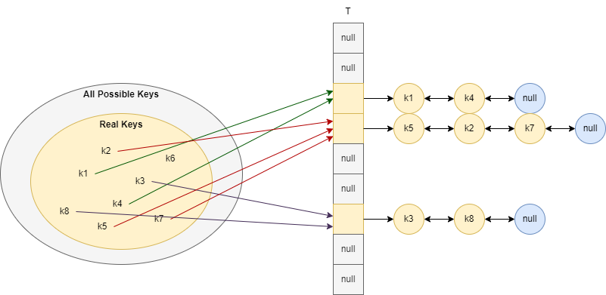
Collision Resolution by Chaining
The average complexity depends on the implementation of hash function.
In case of uniform distribution: T[i] = N/M, where M size of the table, and N the number of possible keys.

Slide 4
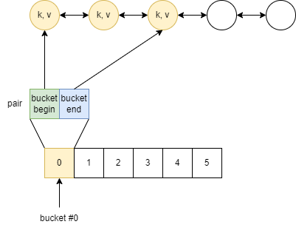


C++ (Visual Studio 2022) Implementation
Simplified scheme of the implementation in C++ (Visual Studio 2022):
Structure:
List of elements;
Vector of pairs (buckets);
Hash function;
Total elements;
Maximum loading factor [0, 1];
Elements: list
Bucket description: pair<>
Buckets: vector
Chaining Approach

Slide 5
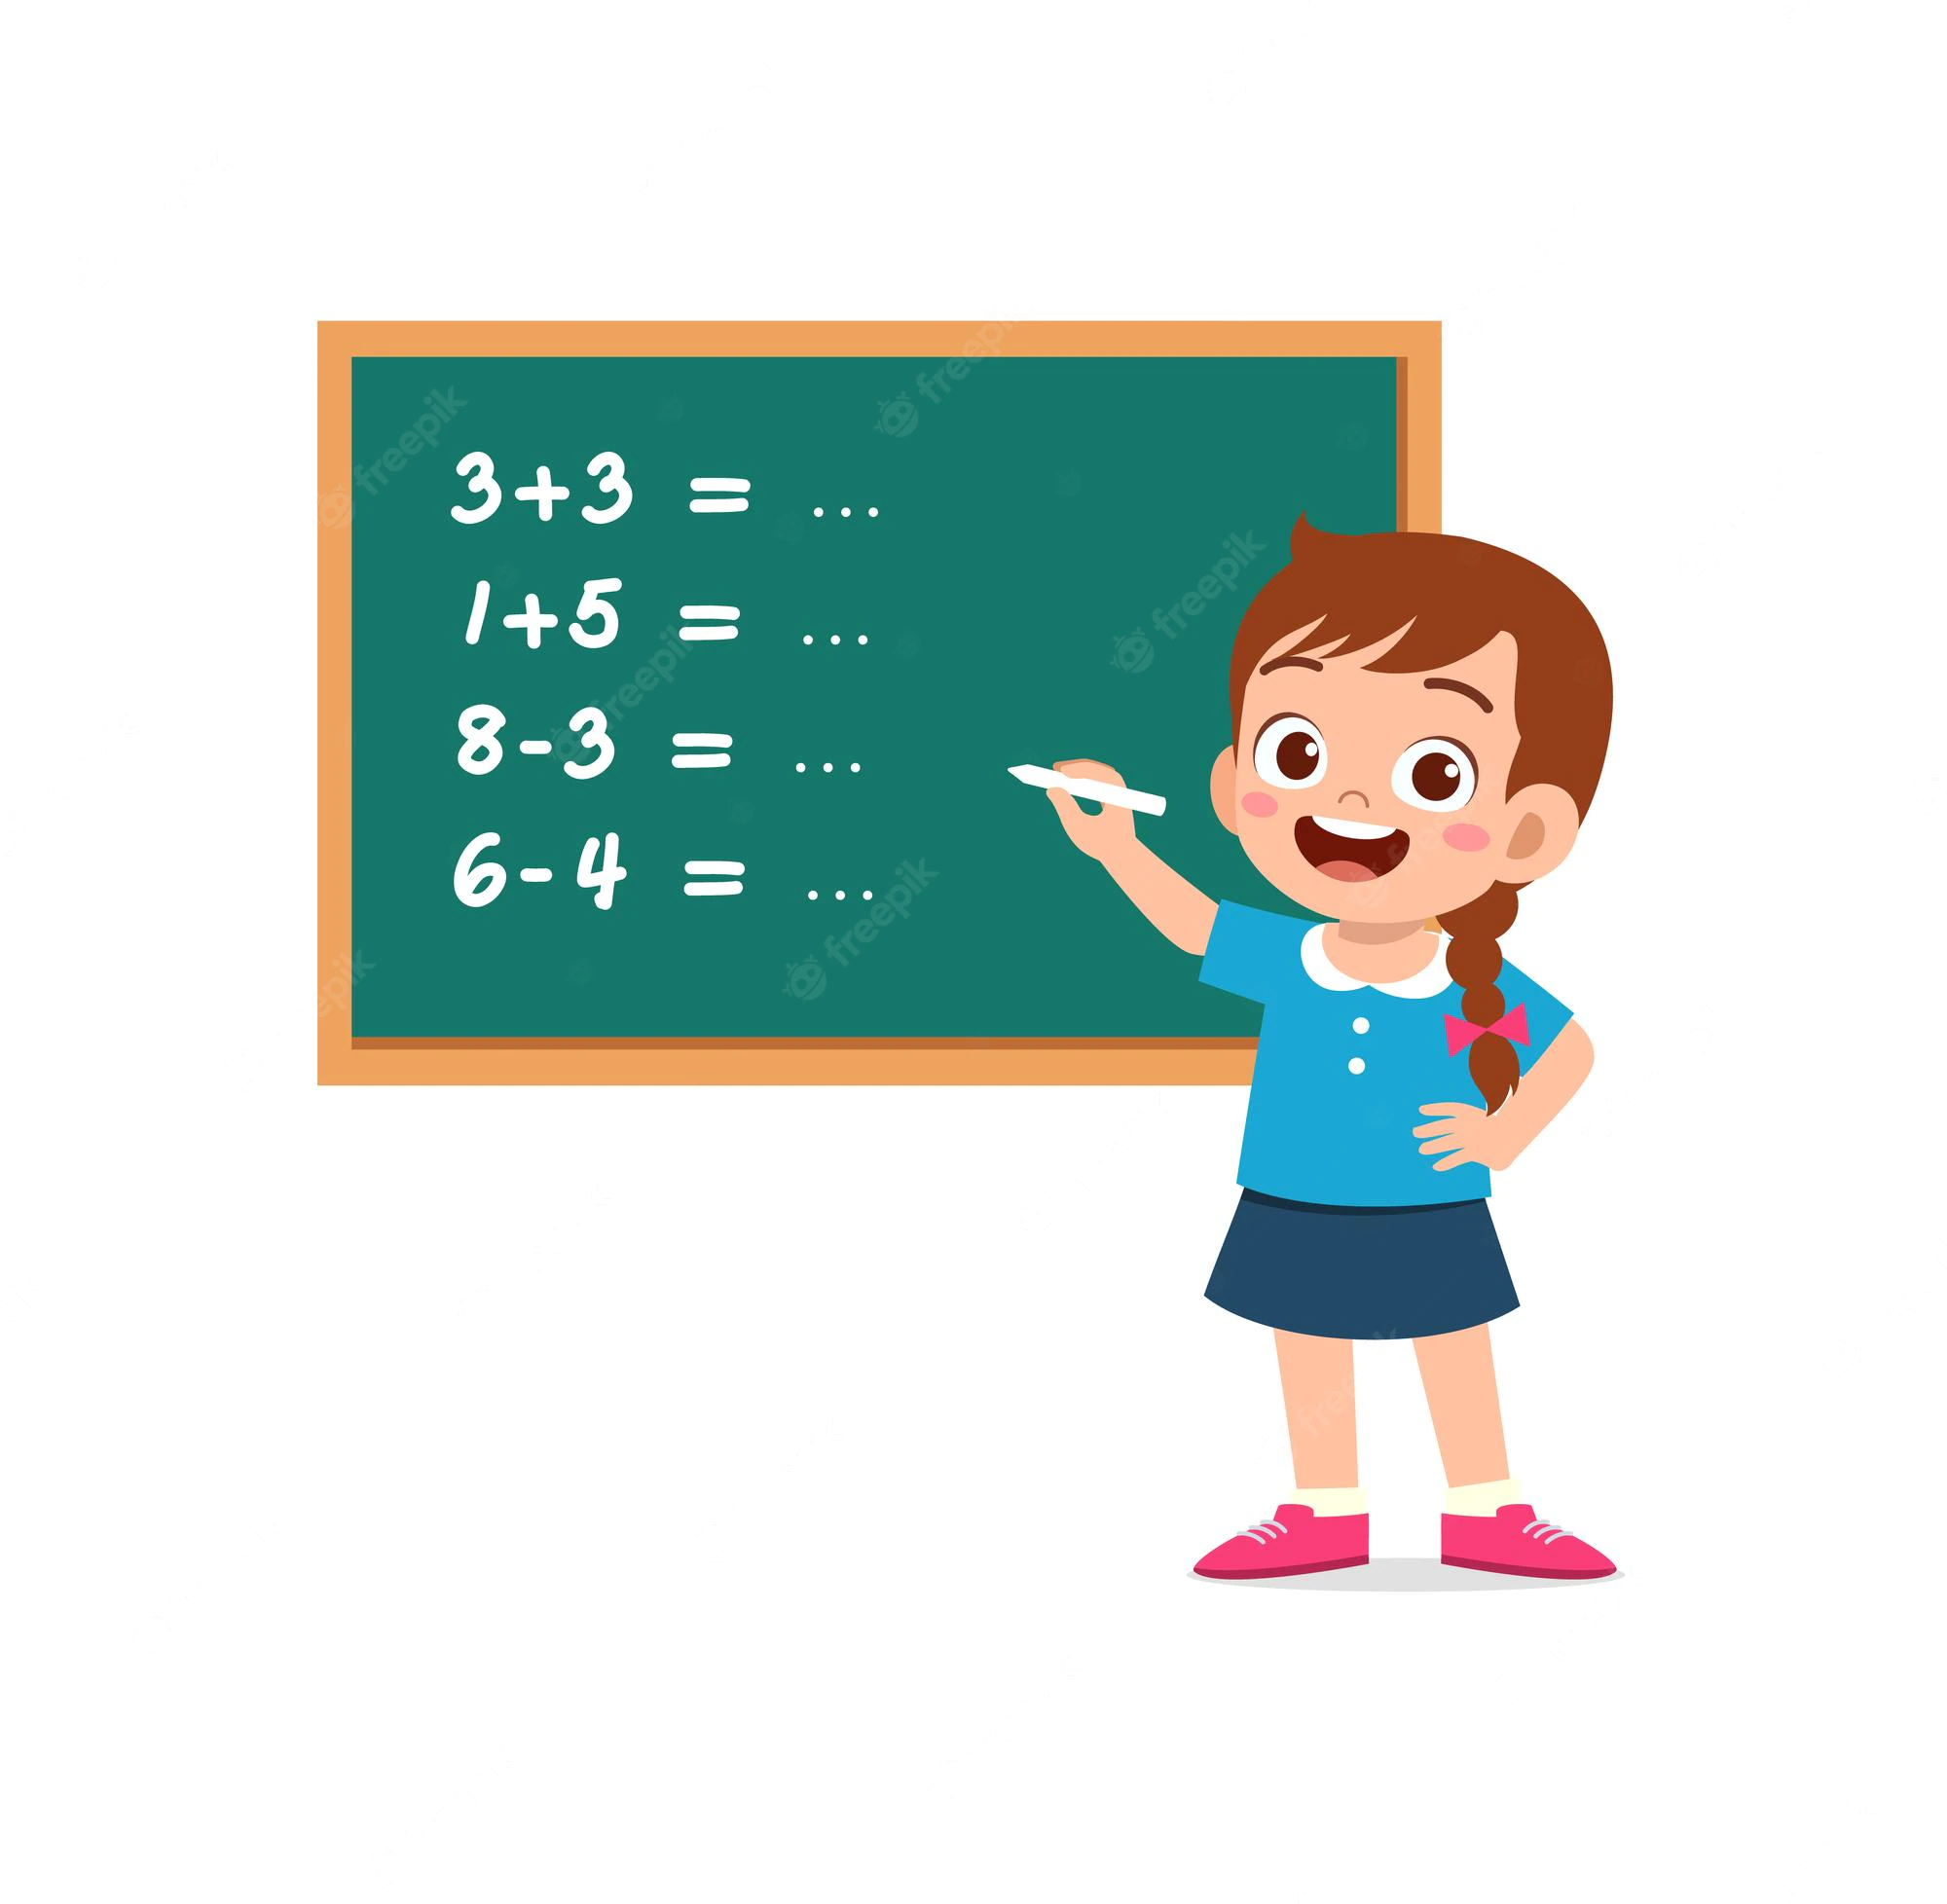
Practice – Implement Own Hash Map
Let's implement own hash map and compare it with C++ implementation.
Collision resolution: chaining;
Hash: key % bucket_size;

Slide 6
Practice – Interesting Problem
If we have time, let’s look into one of the Kattis problems and discuss it:
Join Strings – Link

Slide 7
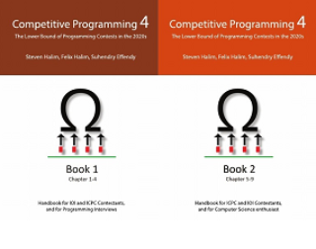
How to Learn and Practice
As one of the recommendation is to use:
Book Competitive Programming 4
Kattis – Link
Online Judge – Link
LeetCode - Link
Few Theory
A Lot of Practice
A Lot of Theory
Almost No Practice

Slide 8
Hometask
Kattis – BASIC Interpreter – Link
Difficulty: 5.5 Hard
Topic: Hash Based Structures

